Slide 1

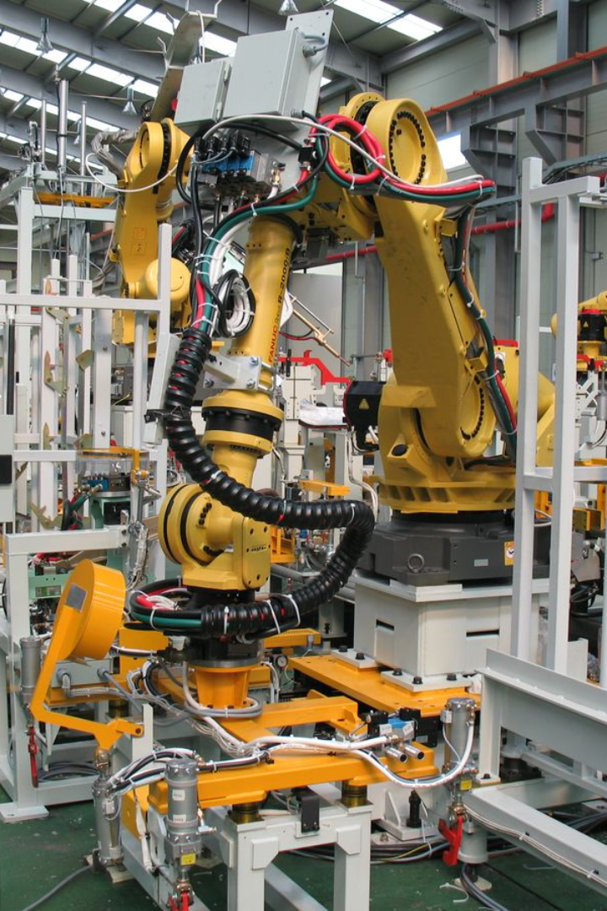
Introduction to Industrial Production Line Management
Understanding the intricacies of managing the production line.

Slide 2

Importance of Real-Time Tracking in Production and Logistics
1
Efficiency Boost
Real-time tracking reduces delays and optimizes resources.
2
Data-Driven Decisions
Access to real-time data allows for informed decision-making.
3
Minimized Errors
Immediate detection and correction of production discrepancies.

Slide 3
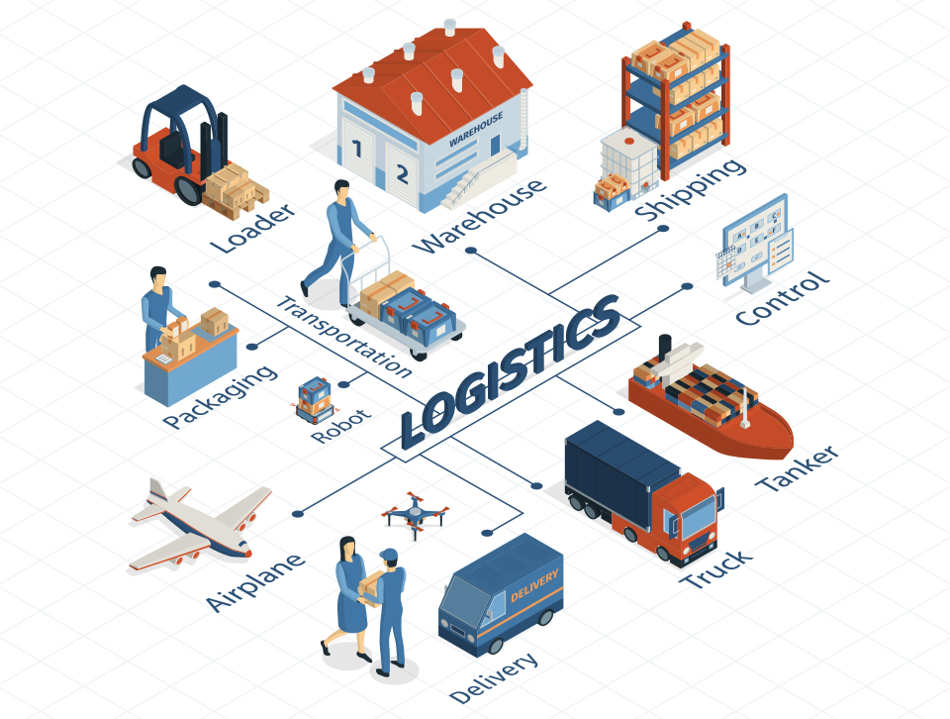
Tracking in Production and Logistics

Slide 4
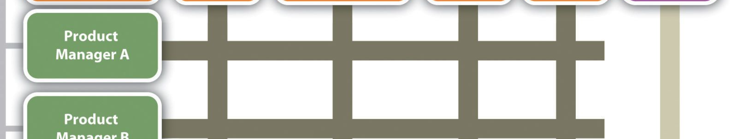
Key Components of Industrial Production Line Management System
Automated Machinery
Data Integration
Quality Control Tools
Connecting various production line components for unified data flow.
Systems for monitoring and ensuring the quality of produced goods.
Technology-driven equipment for seamless operations.

Slide 5
Benefits of Real-Time Tracking in Production and Logistics
1
Enhanced Visibility
2
Cost Savings
Clear insight into the entire production and supply chain processes.
Reduction in wastage and smarter resource allocation.
3
Customer Satisfaction
4
Risk Mitigation
Timely delivery and accurate order fulfillment.
Proactive identification and management of potential issues.

Slide 6
Challenges in Implementing Real-Time Tracking in Production and Logistics
Integration Complexity
Employee Training
Harmonizing real-time systems with existing production infrastructure.
Equipping personnel with the necessary skill set for efficient use of real-time tools.
Data Security
Initial Investment
Ensuring the protection and confidentiality of sensitive operational data.
Fund allocation for the implementation of real-time tracking technology.

Slide 7



Best Practices for Managing Industrial Production Lines with Real-Time Tracking
Continuous Monitoring
Performance Analysis
Collaborative Innovation
Regular and comprehensive oversight of production activities.
Utilizing real-time data for evaluating and improving production efficiency.
Encouraging input from various asset layers to refine processes and strategies.

Slide 8
Conclusion and Key Takeaways
3
20%
Unified Efficiency
Productivity Surge
Streamlining operations, logistics, and management into a cohesive unit.
Substantial increase in overall production output through real-time optimization.
1K
Cost Reduction
Impactful Decisions
Optimized Spending
Thousands of real-time data points driving strategic business choices.
Significant reduction in unnecessary expenses and resource misallocation.

Slide 9
